Slide 1

Software requirements (swr302)
Beyond requirements development
(chapter 19)

Slide 2
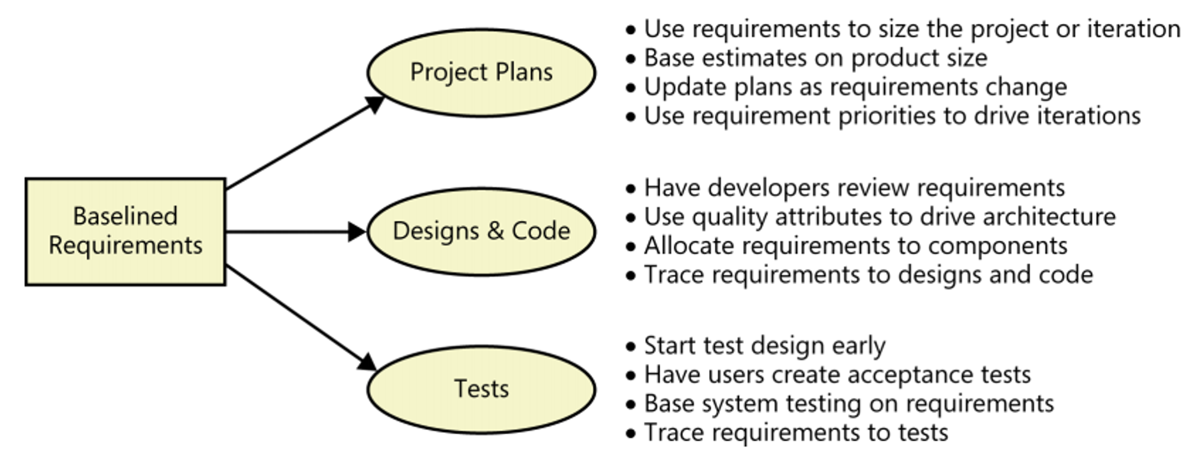
The effects of requirements on software development
Requirements drive project planning, design, coding, and testing activities

Slide 3
Estimating requirements effort
Requirements engineering activity is distributed throughout the project in different ways, depending on whether the project is following a sequential (waterfall), iterative, or incremental development life cycle.
Three complementary estimates
Percent of total work
A developer-to-BA ratio
Activity bottom-up estimate

Slide 4
From requirements to project plans
Estimating project size and effort from requirements
The number of individually testable requirements
Function points
Story points or use case points
The number, type, and complexity of user interface elements
Estimated lines of code needed to implement specific requirements
Requirements and scheduling
Estimated product size
Known productivity of the development team, based on historical performance
A list of the tasks needed to completely implement and verify a feature/UC
Reasonably stable requirements, at least for the forthcoming development iteration
Experience, which helps the project manager adjust for intangible factors and the unique aspects of each project

Slide 5
From requirements to designs & code
Architecture and allocation
Software design
User interface design
From requirements to tests
From requirements to success

Slide 6


